Slide 1
Hardware/Circuit
1
Studied various circuit designs available to acquire ECG Signals
Met senior who had designed the circuit for his device
Simulated circuits designed using sample base designs provided in AD620 Data-sheet, as well as circuits used by senior.
Made modifications to circuit design as per requirements and issues faced.

Slide 2
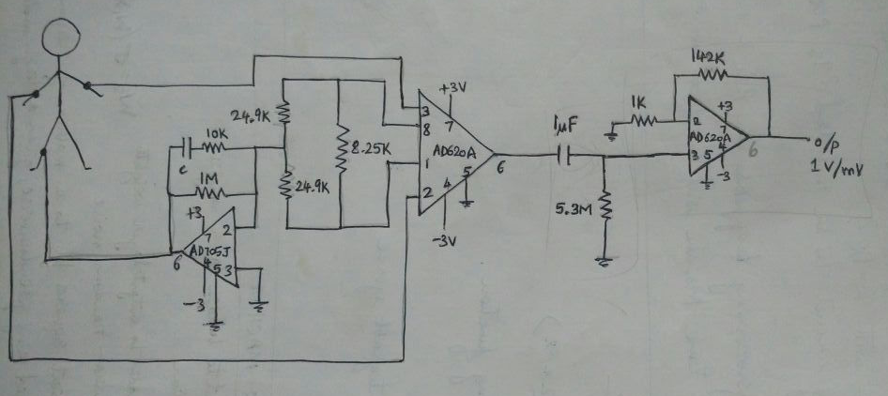
Circuit based on AD620 data-sheet sample
1
Simulated on MultiSim. The leg circuit to provide virtual ground did not work as expected.
Erroneous outputs resulted in abandoning the circuit for other options.

Slide 3
Modified Circuit
1
The circuit designed by senior was interfaced with a bluetooth module. We will not be using bluetooth.
It also contained an integrator circuit in the second stage. We did not understand the use of such a part of the circuit, and resulted in erroneous output.
Certain values of components(Resistors and Capacitors) were changed in order to obtain the necessary gain required.

Slide 4
Circuit overall idea
1
Virtual ground:
To provide a reference with respect to which the voltage at the fingertips can be measured.
The virtual ground will be provided to the thumb, so that the device can be hand held.
Instrumentation amplifier:
Used to measure the differential voltage between the two fingertips on both hands with respect to the virtual ground(thumb).
This stage provides most of the amplification.
Regular amp:
To provide secondary amplification after the instrumentation amplifier, i.e., to spread out the gains.

Slide 5
Modified Circuit
RG=249Ohm
G1=200
Voffset1=3.167mV
Voffset2=45.8mV
G2=5

Slide 6
Design of Sensor and Interface with R-Pi
Max Differential I/P voltage=2.7mV
Leads to saturated output of 2.78V
Max I/P to each electrode=10.2mV
R-Pi does not have analog I/Ps
External ADC required(MPC3008)
10 bit ADC[0-1023]
R-Pi can take I/P from 0-3.3V
Resolution of R-Pi=3.22mV
If we increase supply voltage from 5V, we can increase range of I/P

Slide 7
What next?
Construct the circuit using PDIP components on breadboard.
Test it for specified set of input voltages.
Test it using actual leads on fingertips
Make changes as per required
Go back to testing before proceeding to interface with ADC & R-Pi

Slide 8
Classifier
3
Found ELM documentation by developer.
Currently understanding ELM in order to implement it.
Algorithm:
W1 is the matrix of input-to-hidden-layer weights, σ is some activation function
W2 is the matrix of hidden-to-output-layer weights
Fill W1 with Gaussian random noise;
Estimate W2 by least-squares fit to a matrix of response variables Y, computed using the pseudoinverse, given a design matrix X:
Need to explore SVM
Additional classifers to explore
RVM
parametric and non-parametric models, System Identification

